Slide 1
CUSTOMER
SEGMENTATION
By
T.N.V.S.VATSAL

Slide 2

AGENDA
About the Project
What is Customer Segmentation?
Types of Segmentation factors
Advantages of Customer Segmentation
K-means Algorithm
Tools for the project
Code

Slide 3
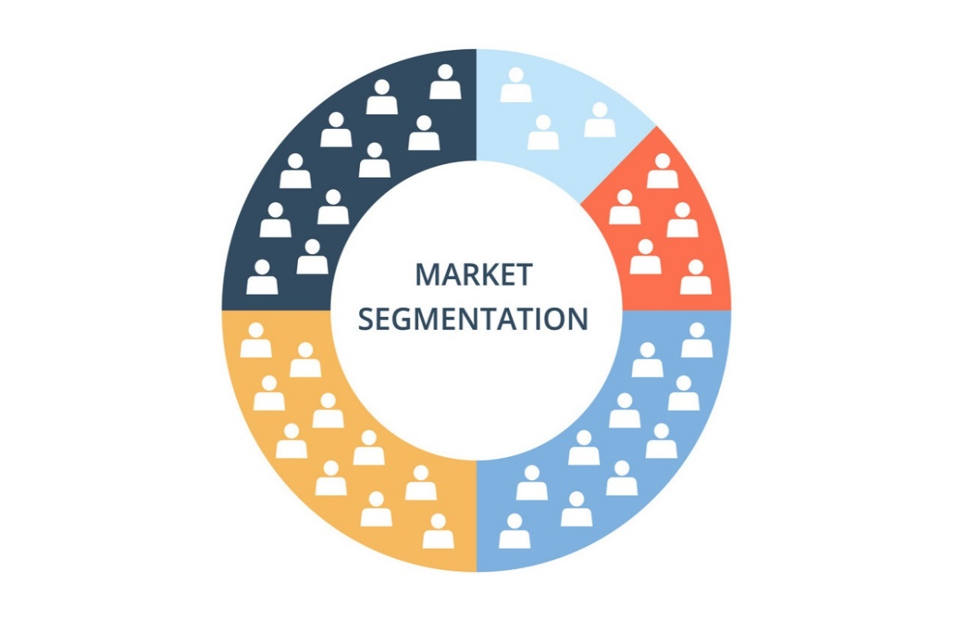
About the Project
Create a business case
Prepare the data
Data analysis and Exploration
Clustering Analysis
Choosing optimal hyperparameters
Visulization and interpretation

Slide 4
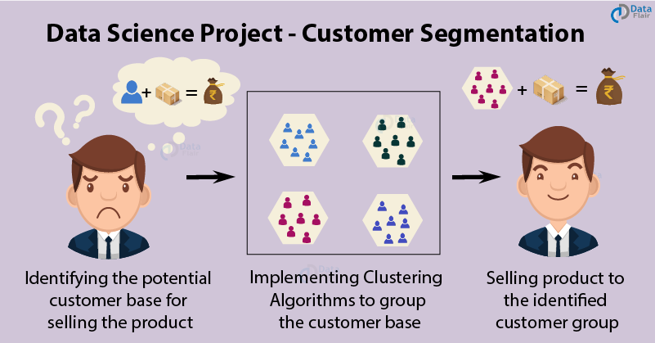
What is Customer Segmentation?

Slide 5
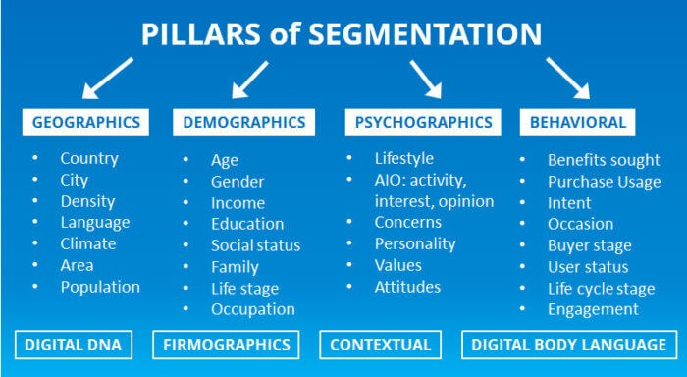
Types of Segmentation Factors

Slide 6
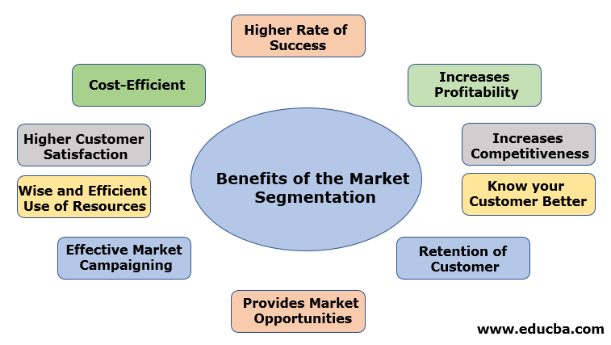
Advantages of Customer Segmentation

Slide 7
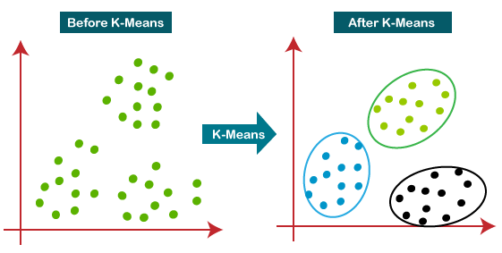
K-means Algorithm
It is an iterative algorithm that divides the unlabelled dataset into k different clusters in such a way that each dataset belongs only one group that
Has similar properties

Slide 8


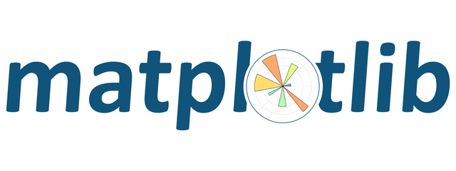


Environments and tools for the Project
Language : Python
Libraries

Slide 9
Thank You

